Slide 1
Analyzing and Managing Networks
Linux 2 Day 2

Slide 2
Today’s Objectives
By the end of class, you will be able to:
Name at least 3 major Linux distributions and explain their use cases.
Create files and folders.
Articulate the purpose of the major directories on Linux filesystems.
Use apt to install packages.

Slide 3
ifconfig/iwconfig

Slide 4
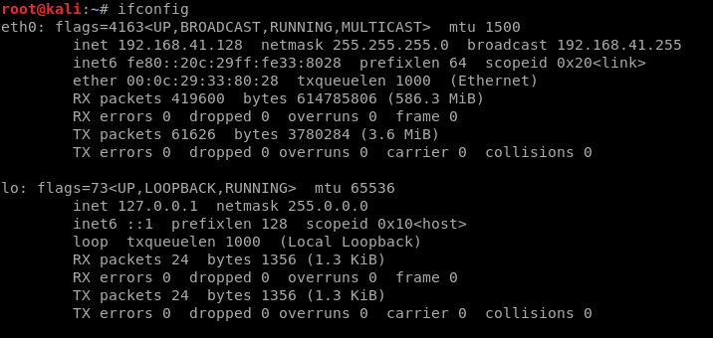

Slide 5
Notes:
1. This is your interface. Linux starts counting at 0. This is your first wired interface.
2. IP address currently assigned to that interface
3. Network Mask / Subnet Mask. Determines which part of the IP is connected to the local network.
4. Broadcast Address – this is the address used to send out information to all IPs on the subnet

Slide 6
Notes:
LO is short for loopback address. This is used so that your computer can talk to programs on the same computer. Local web server, etc.

Slide 7
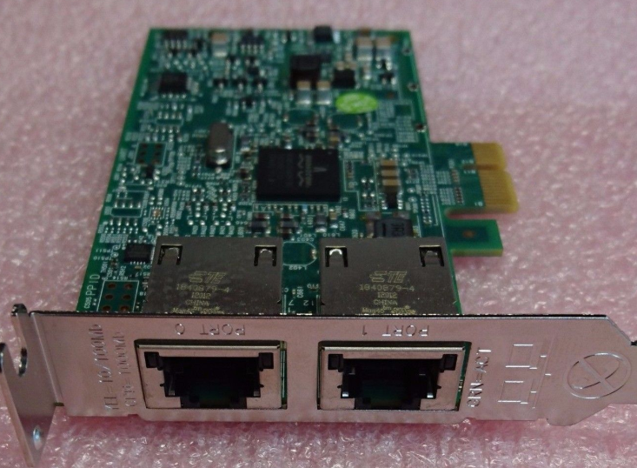
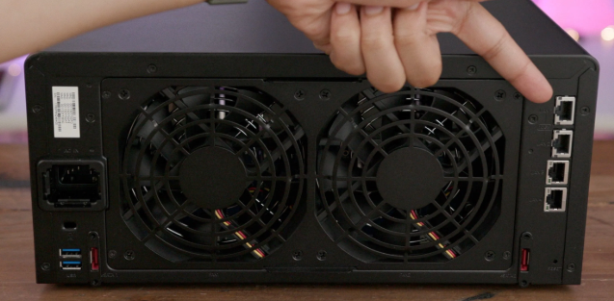
Interfaces
A network interface is a place where a device connects to a network.

Slide 8
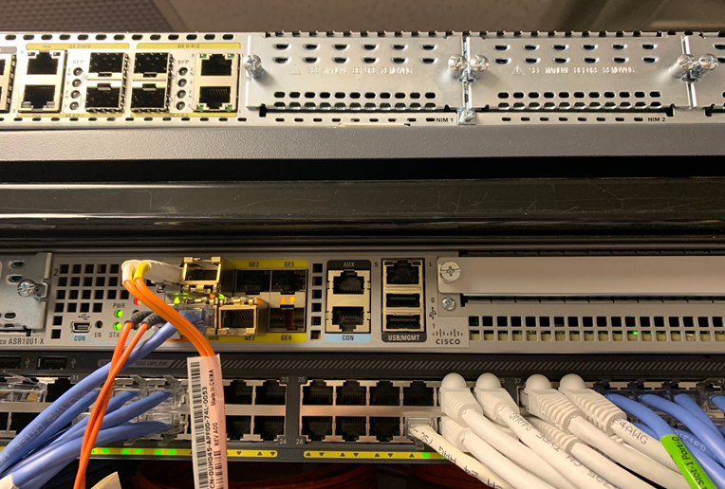
Interfaces

Slide 9
A interface needs to know…
An IP address
A default gateway
A subnet mask
Notes:
* Its IP address. Without this, it doesn't know what traffic is for it and what isn't for it.
* A default gateway. This is where you send traffic that isn't local to you. It's usually the IP address of your router, or firewall, or whatever will be forwarding your traffic on to some other network that is beyond what is local.
* Subnet Mask: Determiens what gets sent to the default gateway vs what is local traffic. Your printer, your TV, your mom's computer, whatever.
* If your subnet mask is incorrect you'll either be sending traffic that's supposed to be local out to computers outside your network or sending traffic ment for the internet will be sent locally, trying to use something like ARP, and timing out.

Slide 10
A interface needs to know…
An IP address
Without this, it doesn’t know what traffic is for it and what isn’t for it.
A default gateway
A subnet mask
Notes:
* Its IP address. Without this, it doesn't know what traffic is for it and what isn't for it.
* A default gateway. This is where you send traffic that isn't local to you. It's usually the IP address of your router, or firewall, or whatever will be forwarding your traffic on to some other network that is beyond what is local.
* Subnet Mask: Determiens what gets sent to the default gateway vs what is local traffic. Your printer, your TV, your mom's computer, whatever.
* If your subnet mask is incorrect you'll either be sending traffic that's supposed to be local out to computers outside your network or sending traffic ment for the internet will be sent locally, trying to use something like ARP, and timing out.

Slide 11
A interface needs to know…
An IP address
Without this, it doesn’t know what traffic is for it and what isn’t for it.
A default gateway
This is where you forward traffic that goes to some other network.
A subnet mask
Notes:
* Its IP address. Without this, it doesn't know what traffic is for it and what isn't for it.
* A default gateway. This is where you send traffic that isn't local to you. It's usually the IP address of your router, or firewall, or whatever will be forwarding your traffic on to some other network that is beyond what is local.
* Subnet Mask: Determiens what gets sent to the default gateway vs what is local traffic. Your printer, your TV, your mom's computer, whatever.
* If your subnet mask is incorrect you'll either be sending traffic that's supposed to be local out to computers outside your network or sending traffic ment for the internet will be sent locally, trying to use something like ARP, and timing out.

Slide 12
A interface needs to know…
An IP address
Without this, it doesn’t know what traffic is for it and what isn’t for it.
A default gateway
This is where you forward traffic that goes to some other network.
A subnet mask
Determines what gets sent to the local network vs what goes to the default gateway.
Notes:
* Its IP address. Without this, it doesn't know what traffic is for it and what isn't for it.
* A default gateway. This is where you send traffic that isn't local to you. It's usually the IP address of your router, or firewall, or whatever will be forwarding your traffic on to some other network that is beyond what is local.
* Subnet Mask: Determines what gets sent to the default gateway vs what is local traffic. Your printer, your TV, your mom's computer, whatever.
* If your subnet mask is incorrect you'll either be sending traffic that's supposed to be local out to computers outside your network or sending traffic ment for the internet will be sent locally, trying to use something like ARP, and timing out.

Slide 13
Let’s say you’re at home…

Slide 14

A packet’s path
I wanna talk to Google….
I’m not Google, so I better use my send the packet to my default gateway…

Slide 15
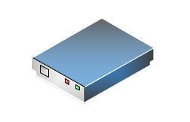
A packet’s path
192.168.1.1
Notes:
Your home router has a little bit more of a complicated decision. It has to figure out if this is on its home network (192.168.1.something) or does it need to go somewhere else. It's not, so I'm going to use MY default gateway, which is your ISP's router.

Slide 16
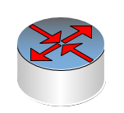
A packet’s path
ISP Router
Notes:
Your ISP has to figure out is this other customer traffic that has to go through one of my other interfaces to talk to customers or do I need keep going.
During all of this, each router asks itself "Do I know where to send this? No? I'm gonna send it to my gateway."

Slide 17
A packet’s path
ISP Router
Notes:
Your ISP has to figure out is this other customer traffic that has to go through one of my other interfaces to talk to customers or do I need keep going.
During all of this, each router asks itself "Do I know where to send this? No? I'm gonna send it to my gateway."

Slide 18
Eventually….
Backbone (Core) Router
Notes:
Eventually, you'll get to a router that knows every direction/decision. It has no default gateway. This is called a backbone router. It is a router that knows, given any IP address, where the packet needs to go.

Slide 19
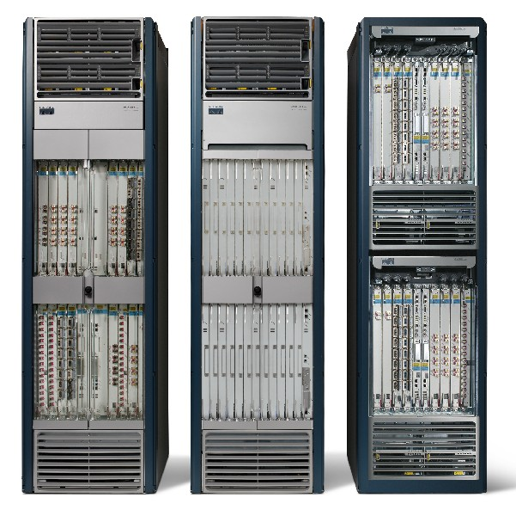
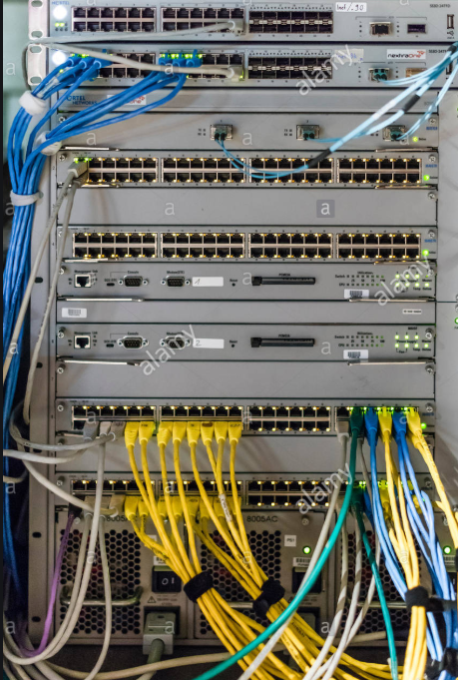
Eventually….
Notes:
Eventually, you'll get to a router that knows every direction/decision. It has no default gateway. This is called a backbone router. It is a router that knows, given any IP address, where the packet needs to go.

Slide 20
Trace Route
Look at the man page and -- help page for traceroute
Use the command to trace the path of a website of your choosing. Take note of how many “hops” occurred.
What do each of these hops indicate?
Run the command again on the same website. Was the same path taken?
Did some “hops” time out? Why?

Slide 21
Linux History and Distros

Slide 22
How the Internet Gives us Away

Slide 23
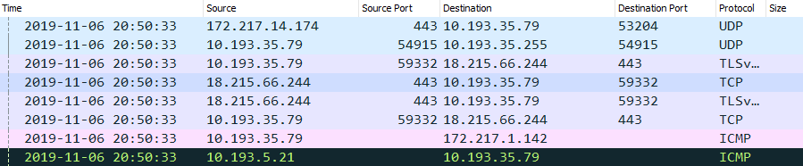
IP addresses
When you send a packet of data across the internet, it contains the IP addresses of the source and destination for the data.
Notes:
As the packet moves across the internet, anyone intercepting it can see who sent it and where it was intended to go, in addition to where it’s been.

Slide 24
Changing your Network Information

Slide 25
MAC addresses
A MAC address is a unique identifier assigned to a network interface controller.
MAC’s have a corresponding IP assigned to them when they are on a network.

Slide 26
IP Addresses vs MAC Addresses
IP Address
It’s like your full street address:
Ernest Cockrell Jr Hall
301 E Dean Keeton St
Austin, TX 78712
MAC Address
The blue house, with the white fence, and the bad dog that barks all the time, with the dead tree.
Notes:
When someone is sending you a letter conventionally, the mail is routed to your local post office based on the full address. We will compare this with routing of IP over the internet. The post office the mail was sent from could care less about your oak tree.
In the conventional method, the post man would organize his deliveries by street, and go house to house delivering the mail

Slide 27
Activity: Getting Comfy with the CLI
In this activity, you will use terminal to perform basic task like creating and removing files, extracting archives and cutting up and archiving files.
Instructions sent via Slack.
15 Minutes

Slide 28
Getting Comfy with the CLI

Slide 29
Other Basic Commands

Slide 30
Basic Commands
whoami – See who you’re logged in as
ls –l – long listing
ls –la – Shows hidden files
locate – locates every occurrence of that word
locate aircrack-ng
whereis – finds binary files
whereis aircrack-ng
which – Only returns the location of the binaries in the PATH
which aircrack-ng

Slide 31
Processes

Slide 32
Processes and Programs
Processes are subtly different from a program.
Programs are executable files that an operating system knows how to find and run. (Commands like ls and cat)
When you run ls, the operating system has to:
Load the code within the ls program into memory
Read and execute the code with the CPU
Clean up after the program finished running (free up memory, remove temporary files, etc.)
A process is the running code, plus the resources needed to do the job (memory, disk space, etc.)
Notes:
For example, when you run ls, the operating system has to:
Load the code within the ls program into memory
Read and execute the code with the CPU
Clean up after the program finishes running (free up memory that the program has finished using; remove temporary files it saved; etc.)
each of these multiple processes must compete for resources.

Slide 33
Process Demonstration
Process Monitoring
Listing with ps
Demonstrate kill

Slide 34
Activity: Monitoring Processes
In this activity, you will use top to monitor processes, use kill to stop processes, and research signal flags used with the kill command.
Instructions sent via Slack.
10 Minutes

Slide 35
Monitoring Processes

Slide 36
Important Directories in Linux

Slide 37

Important Directories in Linux
Linux has several useful directories that keep track of applications, personal data, and applications.
Understanding these directories is important because we will often need to:
Check log files
Understand where other users keep files
Determine where different types of files are likely to be found on servers we administer / secure.

Slide 38
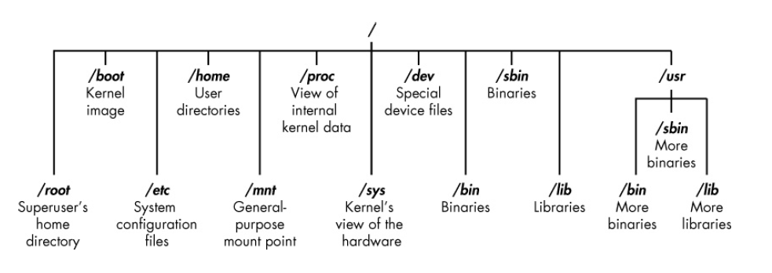
The Linux Filesystem
Notes:
Linux doesn’t have a physical drive (such as the C: drive) at the base of the filesystem but uses a logical filesystem instead. At the very top of the filesystem structure is /, which is often referred to as the root of the filesystem, as if it were an upsidedown tree. Keep in mind that this is different from the root user. The root (/) of the filesystem is at the top of the tree, and the following are the most important subdirectories to know:
/root The home directory of the all-powerful root user
/etc Generally contains the Linux configuration files—files that control when and how programs start up
/home The user’s home directory
/mnt Where other filesystems are attached or mounted to the filesystem
/media Where CDs and USB devices are usually attached or mounted to the filesystem
/bin Where application binaries (the equivalent of executables in Microsoft Windows) reside
/lib Where you’ll find libraries (shared programs that are similar to Windows DLLs)

Slide 39
Important Directories in Linux

Slide 40
Activity: Linux Landmarks
In this activity, you will use top to monitor processes, use kill to stop processes, and research signal flags used with the kill command.
Instructions sent via Slack.
15 Minutes

Slide 41
Linux Landmarks

Slide 43
Nano

Slide 44
Nano
Now that we know where our directories are, we can look into how to make changes and add new files.
Being able to edit files on the command line is essential for any serious Linux user.
Nano is a simple text-editor, pre-built into your Linux instance.
Nano is quicker than opening up other programs
Available in non-GUI environments

Slide 45
Nano

Slide 46
Activity: Nano nano
In this activity, you will learn how to use Nano, a simple text editor.
Instructions sent via Slack.
15 Minutes

Slide 47
Nano nano

Slide 48
Installing Packages

Slide 49
Installing Packages
Just like Windows and Apple machines, we are able to enhance our Linux experience and download additional tools and programs via packages.
Installing packages is a simple process using one commands:
apt-get install <package_name>
Personal Package Archives (PPAs)are Linux repositories that it connects to find the <package_name>.

Slide 50
Activity: Installing Packages
In this activity, you will combine you knowledge of nano and package management to install cowsay and fortune.
Instructions sent via Slack.
15 Minutes

Slide 51
Installing Packages

Slide 52
Today’s Objectives
By the end of class, you will be able to:
Name at least 3 major Linux distributions and explain their use cases.
Create files and folders.
Articulate the purpose of the major directories on Linux filesystems.
Use apt to install packages.

